Slide 1
Maintaining the momentum
Paul Farmer
Chief Executive
mind.org.uk

Slide 2
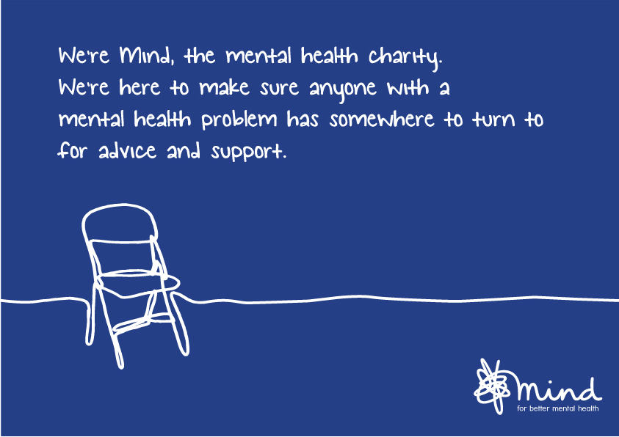

Slide 3
Mental Health – a crucial priority

Slide 4
NHS long-term plan
The headline ambition is to deliver ‘world-class’ mental health care, when and where children, adults and older people need it. The NHS Long Term Plan published on 7 January 2019 commits to grow investment in mental health services faster than the overall NHS budget. This creates a new ringfenced local investment fund worth at least £2.3 billion a year by 2023/24. Further, the NHS made a new commitment that funding for children and young people’s mental health services will grow faster than both overall NHS funding and total mental health spending. This will support, among other things:
Significantly more children and young people from 0 to 25 years old to access timely and appropriate mental health care. NHS-funded school and college-based Mental Health Support Teams will also be available in at least one fifth of the country by 2023.
People with moderate to severe mental illness will access better quality care across primary and community teams, have greater choice and control over the care they receive, and be supported to lead fulfilling lives.
Perinatal mental health care will be expanded for women who need specialist mental health care during and following pregnancy.
The NHS will provide a single-point of access and timely, age-appropriate, universal mental health crisis care for everyone, accessible via NHS 111.

Slide 5
CYP and Perinatal (By 2023/24)
Children and Young People
At least an additional 345,000 children and young people aged 0-25 able to access support via NHS funded mental health services and school or college-based Mental Health Support Teams by 2023/24.
Extend current service models to create a comprehensive offer for 0-25 year olds that reaches across mental health services for children, young people and adults.
Over the next five years the NHS will fund new Mental Health Support Teams working in schools and colleges, building on the support already available, which will be rolled out to between one-fifth and a quarter of the country by the end of 2023.
All children and young people experiencing crisis will be able to access crisis care 24 hours a day, seven days a week by 2023/24.
Perinatal
Increase access to evidence-based care for an additional 24,000 women with moderate to severe perinatal mental health difficulties and a personality disorder diagnosis each year by 2023/24.
Offer partners of women accessing specialist perinatal mental health services and maternity outreach clinics evidence-based assessment for their mental health.
We will integrate maternity, reproductive health and psychological therapy for women experiencing mental health difficulties directly arising from, or related to, the maternity experience in Maternity Outreach Clinics.
Care will be available from preconception to 24 months after birth.

Slide 6
Crisis Care (By 2023/24)
Anyone experiencing mental health crisis will be able to call NHS 111 and have 24/7 access to the mental health support they need in the community by 2023/24.
By 2023/24, 70% of mental health liaison services will meet the ‘core 24’ service standard.
Clear standards for access to urgent and emergency specialist mental health care will be in place. Waiting times targets for emergency mental health services will be in effect by 2020.
Bereavement support for families and staff who are bereaved by suicide, who are likely to have experienced extreme trauma and are at a heightened risk of crisis themselves will be rolled-out to all areas of the country.
We will Improve signposting towards and increase alternative forms of provision for those in crisis, for example, sanctuaries, safe havens and crisis cafes.
New mental health transport vehicles will be introduced.
Mental health nurses will be introduced to ambulance control rooms.
The mental health competency of ambulance staff will be increased through an education and training programme.

Slide 7
Adults with moderate to severe mental health problems (By 2023/24)
By 2023/24, 370,000 adults and older adults with severe mental illnesses will have greater choice and control over their care, and be supported to live well in their communities via new and integrated models of primary and community care.
Test four-week waiting times for adult and older adult community mental health teams.
Further increase the number of people receiving physical health checks to an additional 110,000 people per year, bringing the total to 390,000 checks delivered each year including the ambition in the Five Year Forward View for Mental Health.
The NHS will support an additional 35,000 people with severe mental illnesses to participate in the Individual Placement and Support programme each year by 2023/24, bringing the total to 55,000 people supported per year

Slide 8
Core Mental health LTP ambitions (By 2023/24) (3/4)
Suicide reduction
Full coverage across the country of the existing suicide reduction programme.
Supported by roll out of a Mental Health Safety Improvement Programme with a focus on suicide prevention and reduction for mental health inpatients.
Other commitments
By 2023/24 an additional 380,000 people per year will be able to access NICE-approved IAPT services.
Reduce length of stay in units with a long length of stay to the national average of 32 days.
Ensure that the parts of England most affected by rough sleeping will have better access to specialist homelessness NHS mental health support, integrated with existing outreach services.
Expand geographical coverage of NHS services for people with serious gambling problems, and work with partners to tackle the problem at source.
Implement universal smoking cessation offer as part of specialist mental health services.
Support the development of apps and online resources to support good mental health and enable recovery.
All mental health providers will reach a core level of digitisation by 2024.
Extended the Getting It Right First Time (GIRFT) programme across to community health services and primary care from April 2019.

Slide 9
Next steps with implementation
NHS England are developing an implementation framework (guidance for local areas) to be published in Spring
All STPs/ICSs will be expected to produce a local plan to deliver the LTP – we are expecting these will be completed by August
Proposals from clinical review of access standards published
Consultation on legal changes to expedite implementation of LTP - changes to application of competition law, enabling the speedier development of ICSs and merging NHSE and NHSI.
Draft workforce plan expected in April; local workforce planning
Capital, training and public health spending will allocated in the Spending Review
National Implementation Plan published in the Autumn

Slide 10
Restormel and Carrick Mind provide a range of preventative wellbeing services to support people living in Cornwall
- Newquay Wellbeing
- St Austell Wellbeing
- Newquay Fitness to Wellbeing
- Art for Wellbeing (Newquay and Bodmin)
- Music for Wellbeing (Bodmin)
- Walking for Wellbeing (Newquay and Bodmin)
- Yoga for Wellbeing (Bodmin and Falmouth)
- Soil to Soup and SPADES (Bodmin) and Falmouth Allotment group
- Bodmin Charity Shop providing Mentoring into Work
- Community Café’s (Falmouth and Truro)
Get Set to Go programme in partnership with Sport England and the Cornwall Sports Partnership .
It aims to improve the quality of life for anyone with a mental heath problem through access to sport and physical activity in the local community.

